Slide 1
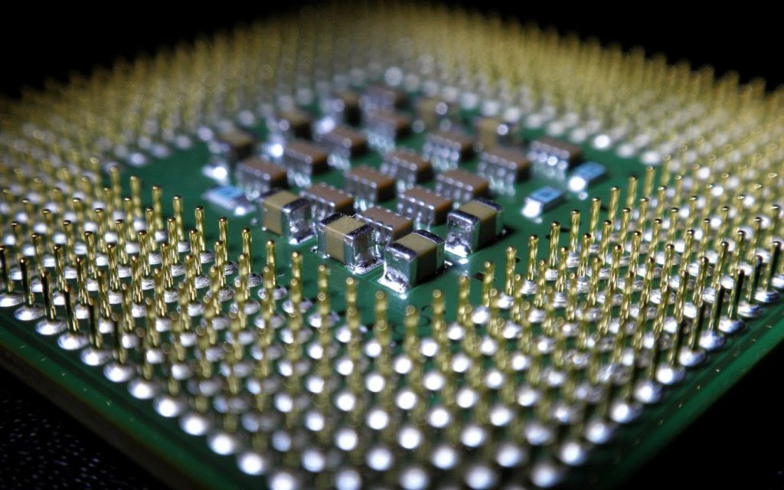
Multicore Technology

Slide 2
Multicore technology means one CPU has two or more cores.
A core is a small processor inside the CPU.
Each core can do its own work.

Slide 3
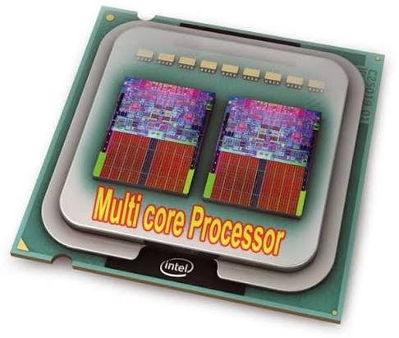
MULTI CORE PROCESSOR

Slide 4
Multicore processors make computers faster.
They can run many programs at the same time.
Dual-core means the CPU has 2 cores.

Slide 5
Quad-core means the CPU has 4 cores.
Hexa-core means the CPU has 6 cores.
Octa-core means the CPU has 8 cores.

Slide 6
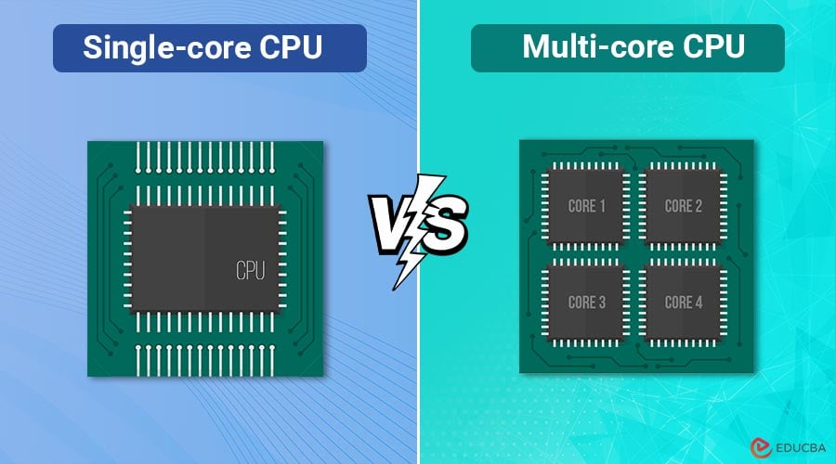

Slide 7
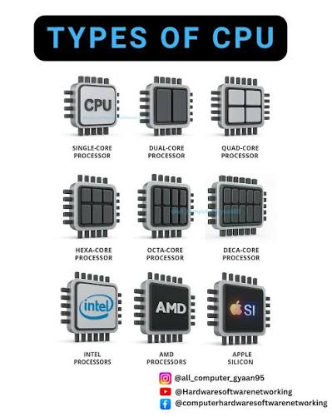

Slide 8
More cores can improve performance.
Multicore CPUs help with multitasking.
They reduce waiting time.

Slide 9
They improve system speed.
They help applications run smoothly.
They are used in computers and laptops.

Slide 10
Smartphones also use multicore processors.
Tablets use multicore technology too.
Servers use many-core processors.

Slide 11
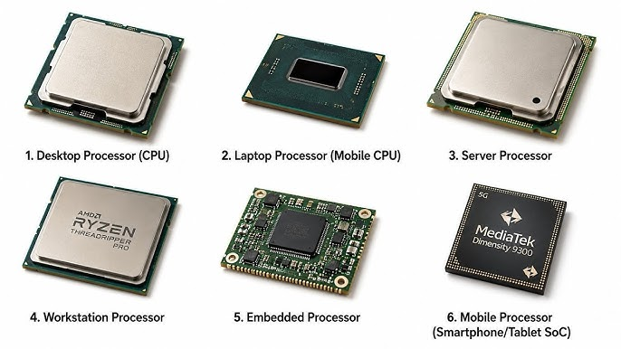

Slide 12
Gaming computers use multicore CPUs.
Modern software supports multicore processing.
Each core can run a different task.

Slide 13
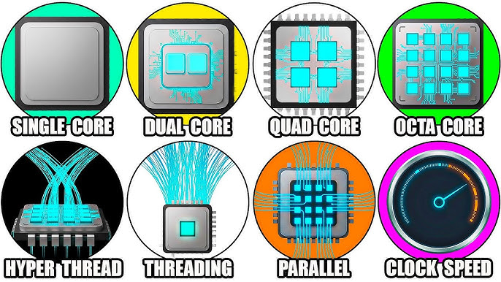

Slide 14
Multicore CPUs save time.
They increase productivity.
They improve video editing performance.

Slide 15
They make gaming smoother.
They help in 3D rendering.
They support virtual machines.

Slide 16
They improve software development work.
They are useful for data processing.
They handle large files easily.

Slide 17
Multicore processors use parallel processing.
Parallel processing means doing many tasks together.
The operating system manages all cores.

Slide 18
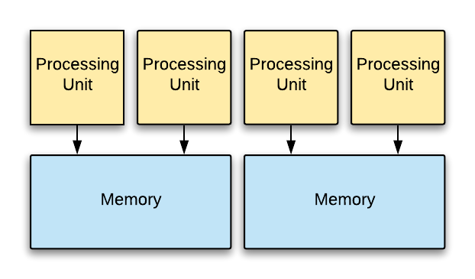

Slide 19
Threads can run on different cores.
Programs work faster when they use multiple cores.
More cores do not always mean better performance.

Slide 20
Software must support multicore processing.
Good cooling is important for multicore CPUs.
Multicore processors generate heat.

Slide 21
Cooling systems help keep the CPU safe.
Intel makes multicore processors.
AMD also makes multicore processors.

Slide 22
Apple designs multicore chips for its devices.

Slide 23
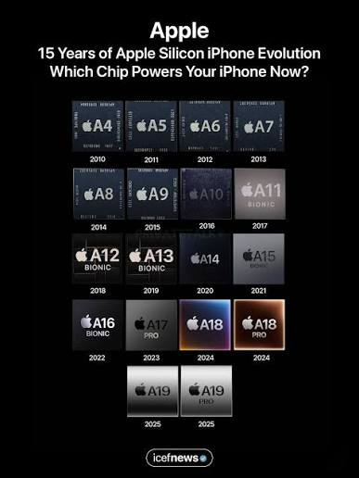

Slide 24
Multicore processors improve energy efficiency.
They reduce power consumption compared to older designs.

Slide 25
They increase computer reliability.
Most modern devices use multicore technology.
Multicore technology is important in artificial intelligence.

Slide 26
It is also used in cloud computing.
Multicore technology makes computers faster, smarter, and more efficient.

